Slide 1
Building iOS Swift apps
5030-201720_MCS5993_M: 5030-Topics in Computer Science
5031-201720_MCS4993_M: 5031-Topics in MA/CS

Slide 2
Agenda
App Store
Unit Testing
Assignment – upload build to app store

Slide 3

App Store Icons

Slide 4
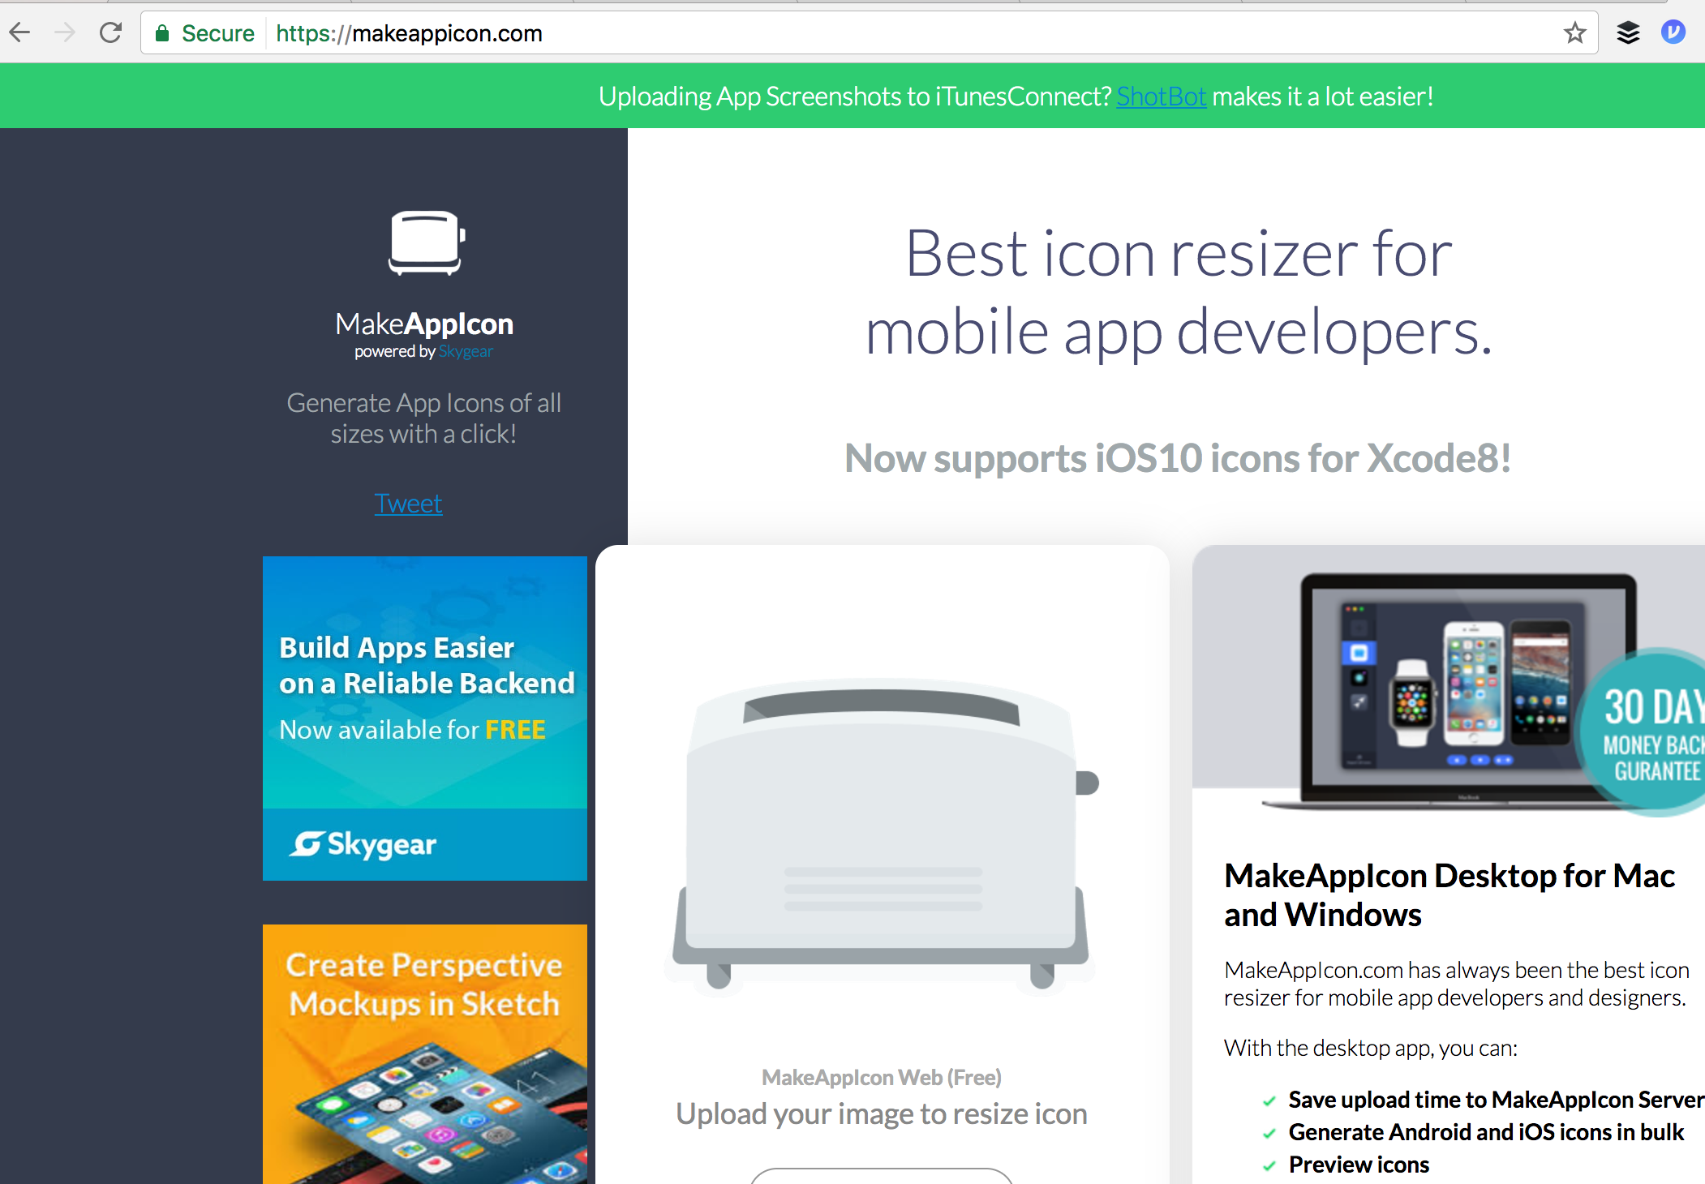
App Store Icons

Slide 5
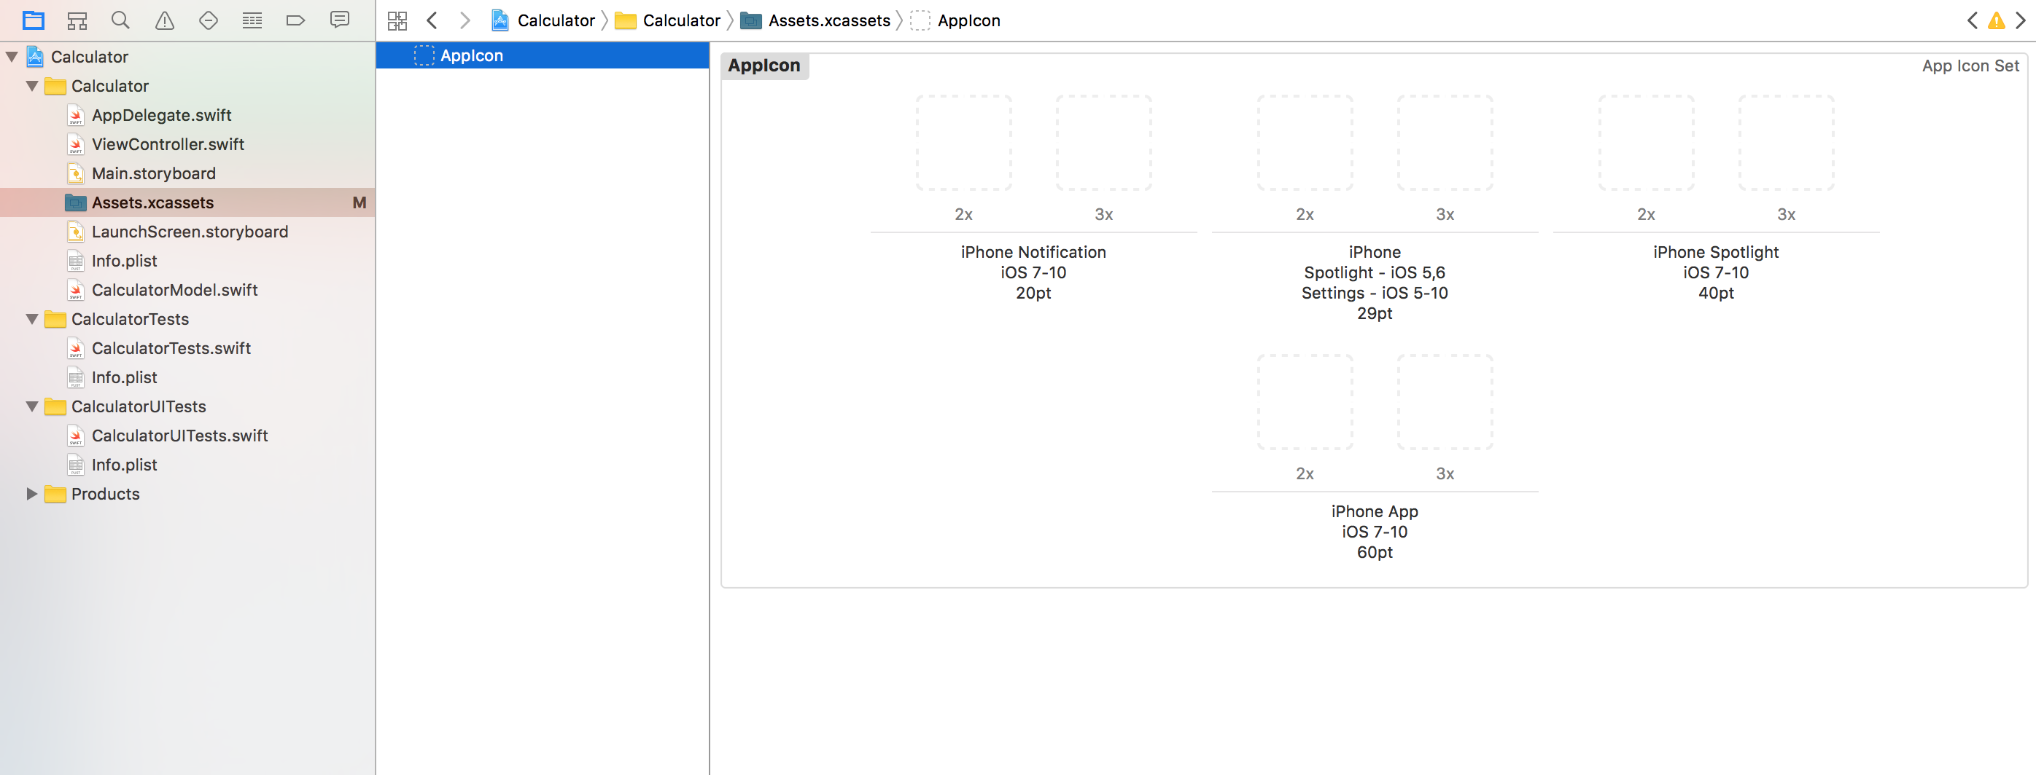
App Store Icons

Slide 6
App Store Icons

Slide 7
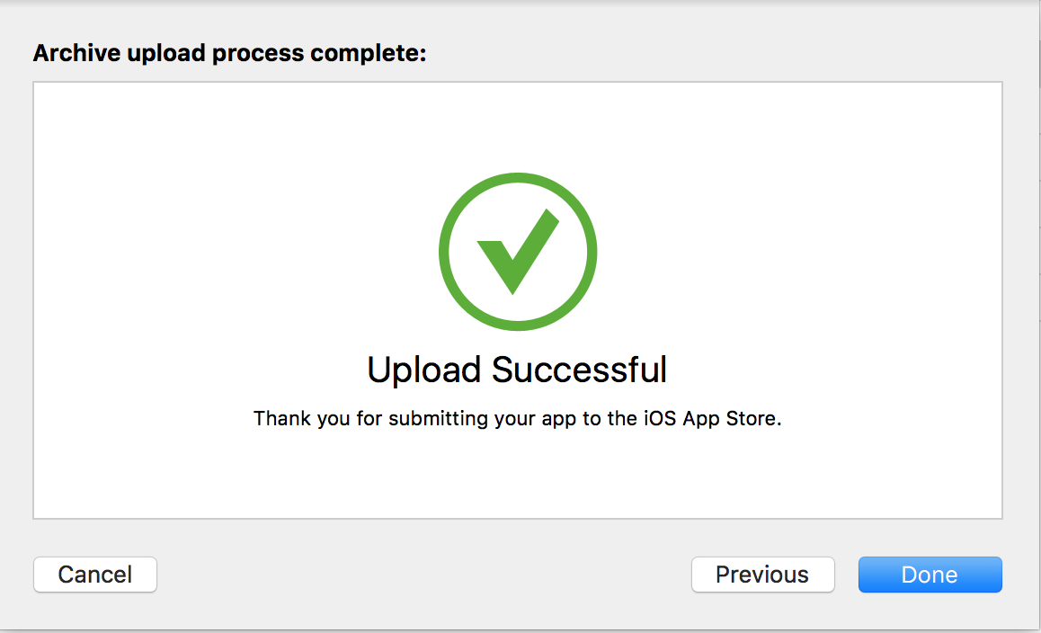
App Store

Slide 8
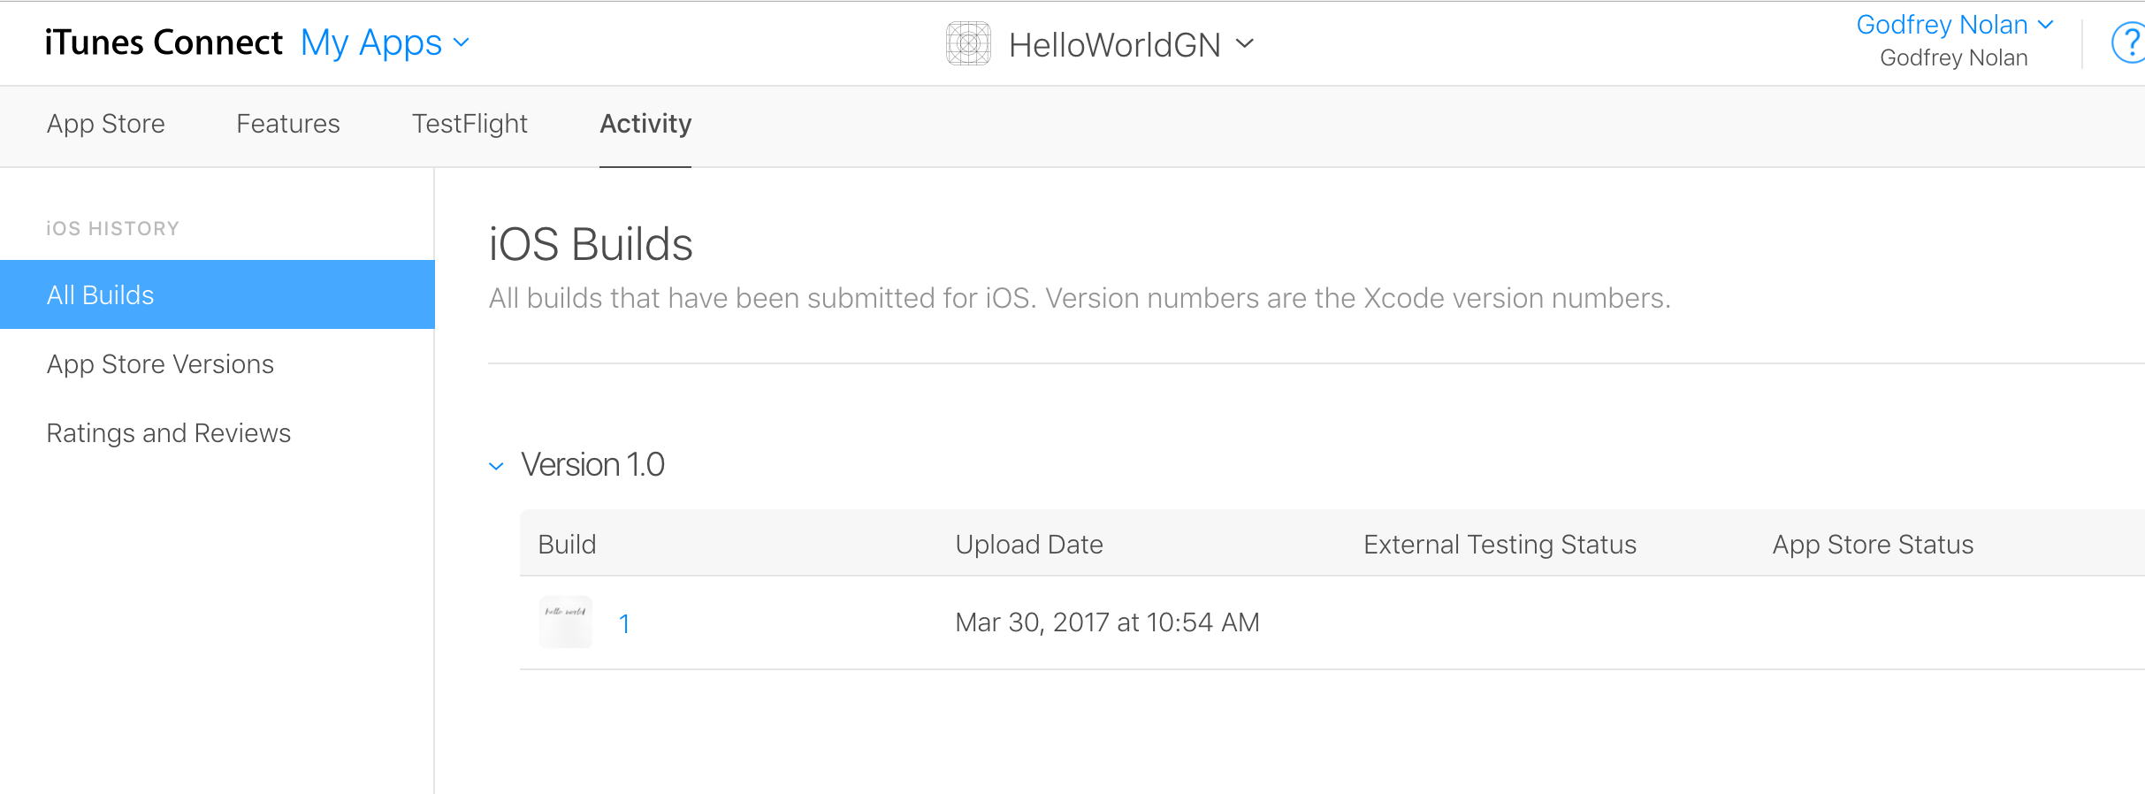
App Store
Notes:
Submit for review before adding build

Slide 9
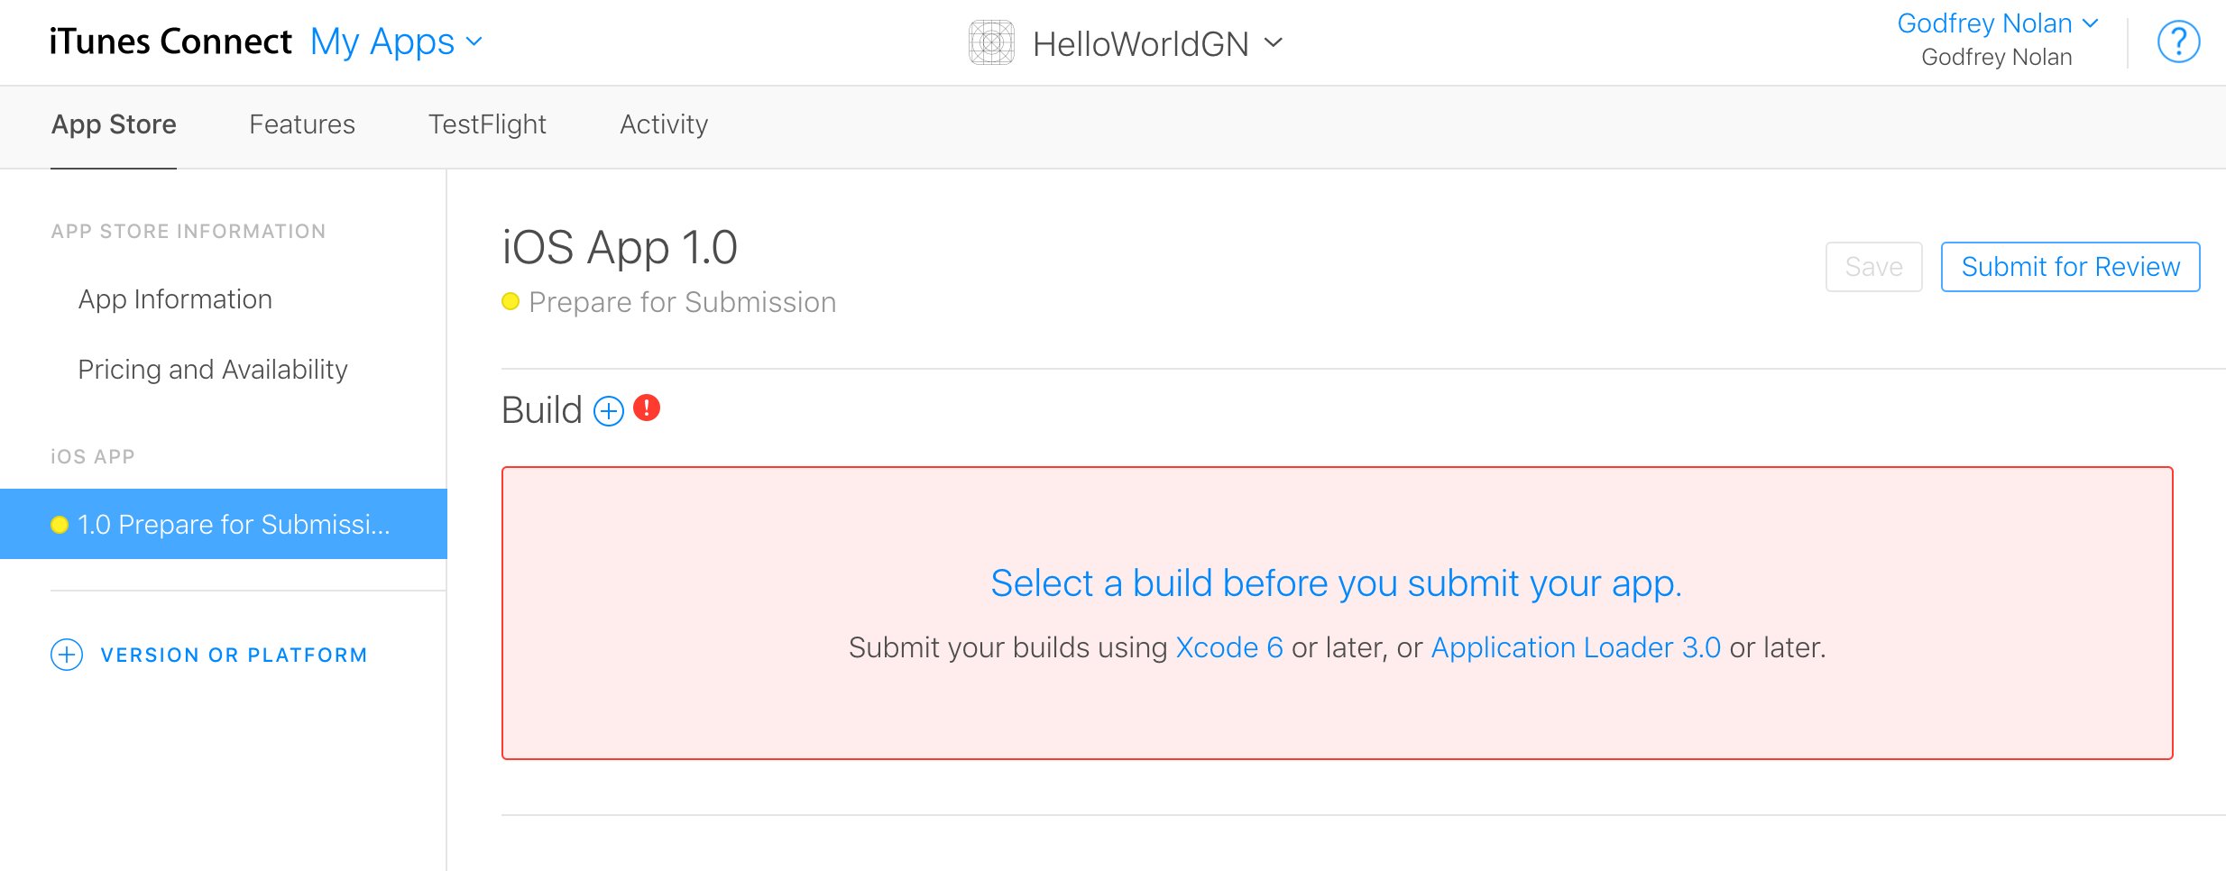
App Store
Notes:
Submit for review before adding build to see if there’s anything missing.

Slide 10
Unit Testing Intro
Hello World
Benefits
Testing Pyramid
UI Testing

Slide 11
Hello World Unit Test – swift package init
struct HelloWorld {
var text = "Hello, World!”
}
Notes:
swift package init

Slide 12
Hello World Unit Test – swift package init
import XCTest
@testable import HelloWorld
class HelloWorldTests: XCTestCase {
func testExample() {
XCTAssertEqual(HelloWorld().text, "Hello, World!")
}
}
Notes:
import XCTest
@testable import HelloWorld
class HelloWorldTests: XCTestCase {
func testExample() {
XCTAssertEqual(HelloWorld().text, "Hello, World!")
}
}

Slide 13
Unit Testing Benefits
Catch more mistakes
Confidently make more changes
Built in regression testing
Extend the life of your codebase

Slide 14
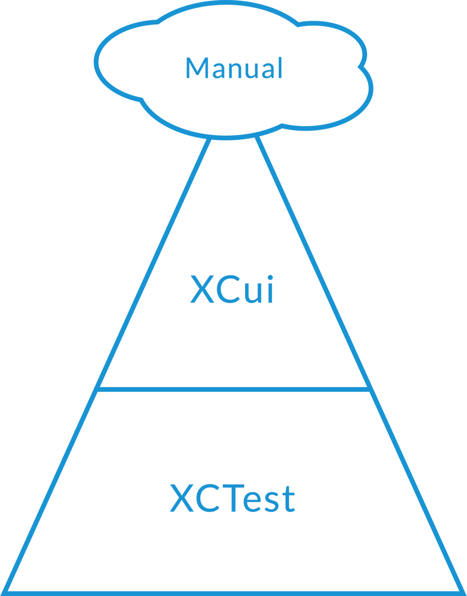
Unit Testing Benefits

Slide 15
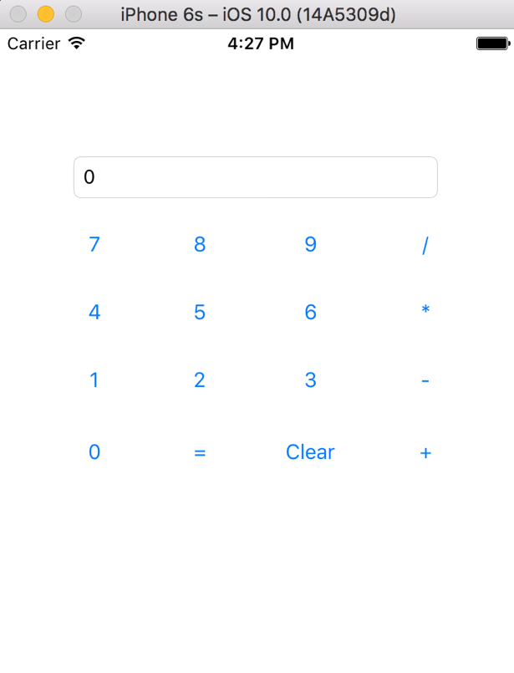
Unit Testing

Slide 16
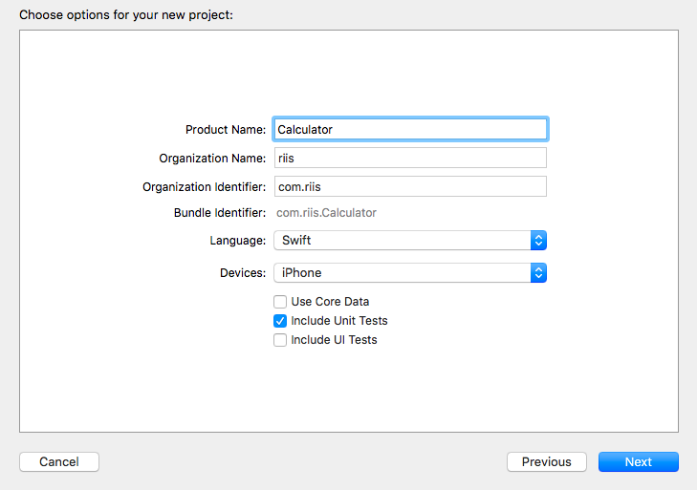
Unit Testing

Slide 17
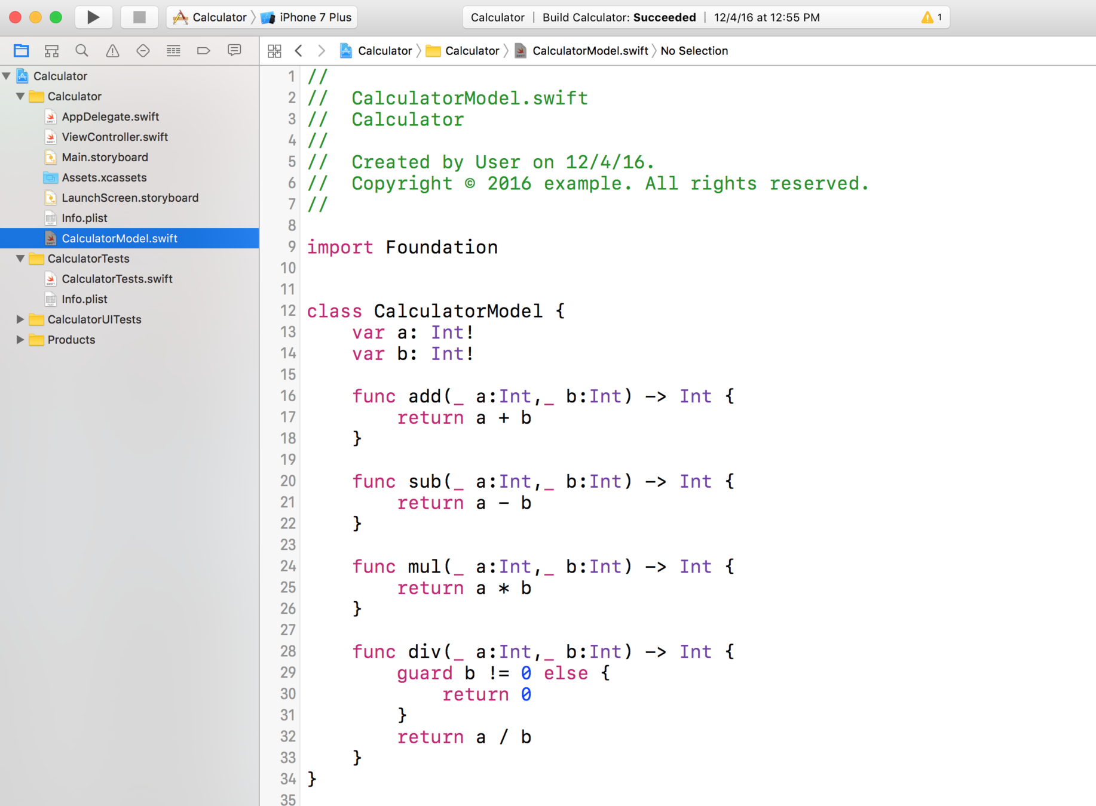
Unit Testing

Slide 18
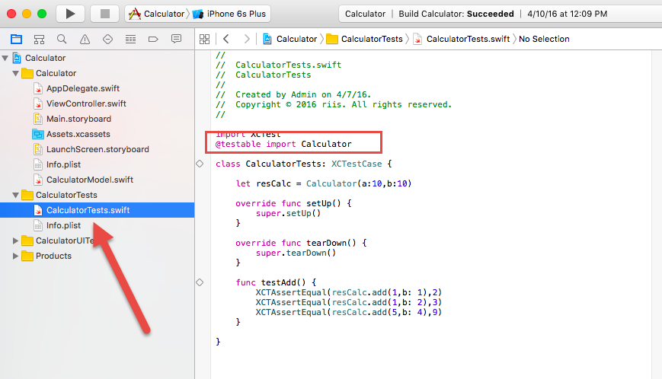
Unit Testing

Slide 19
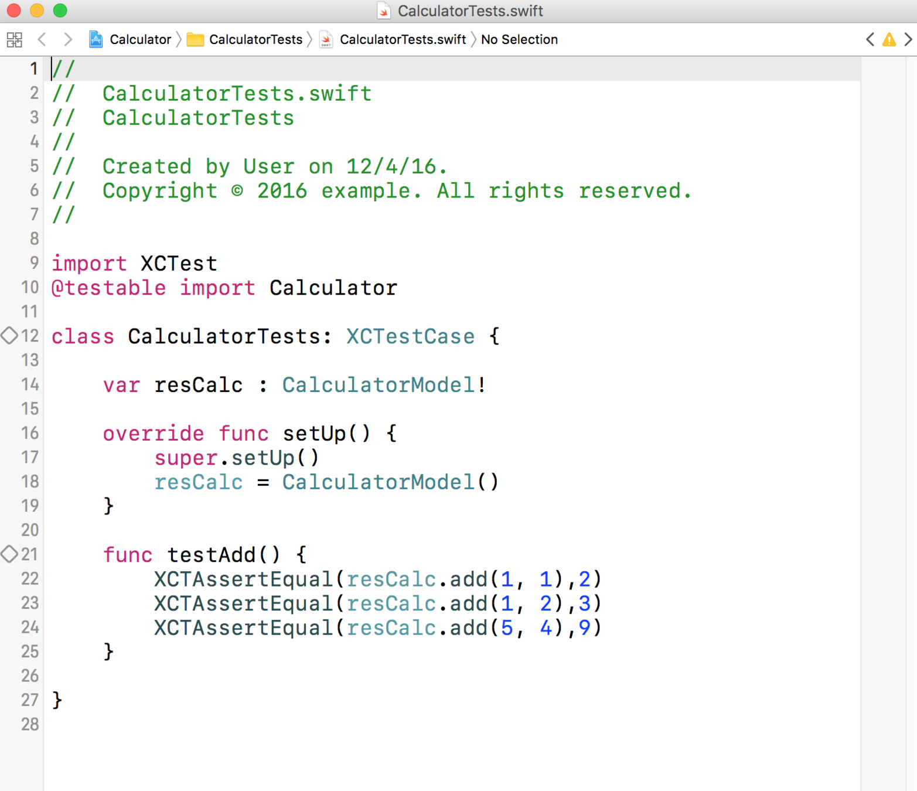
Unit Testing

Slide 20
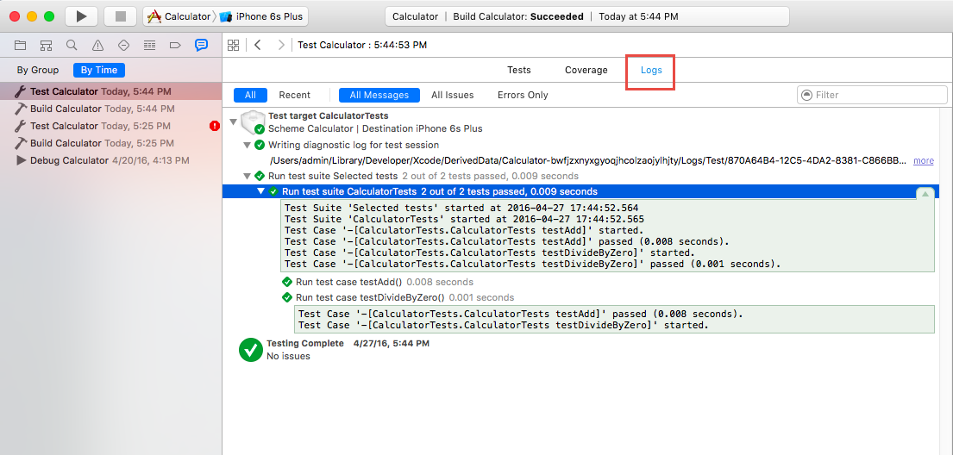
Unit Testing

Slide 21
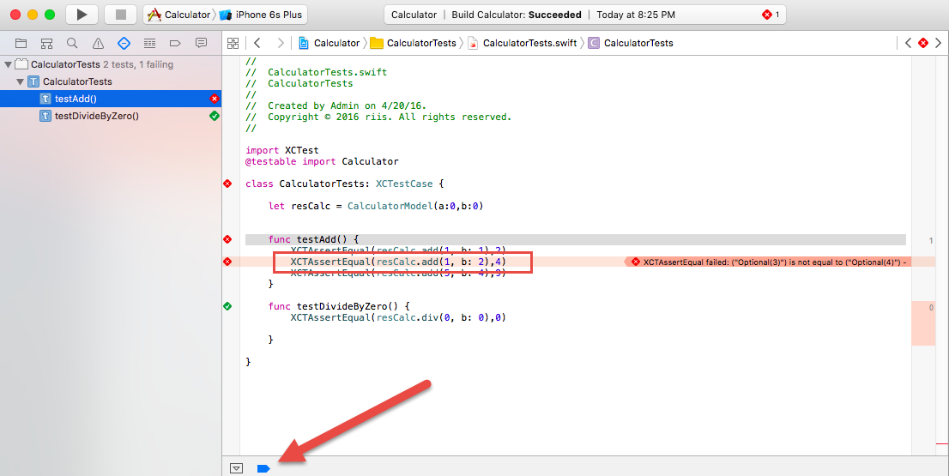
Unit Testing

Slide 22
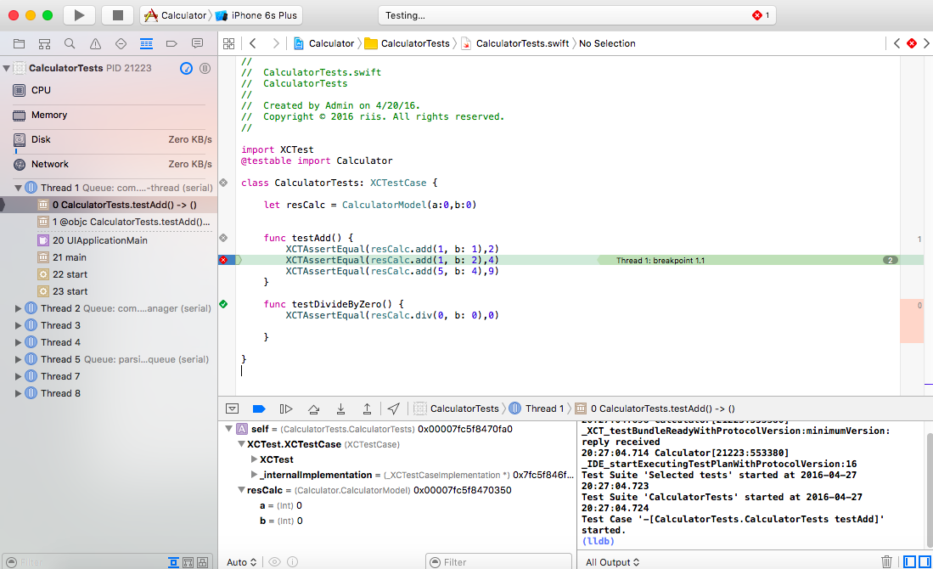
Unit Testing

Slide 23
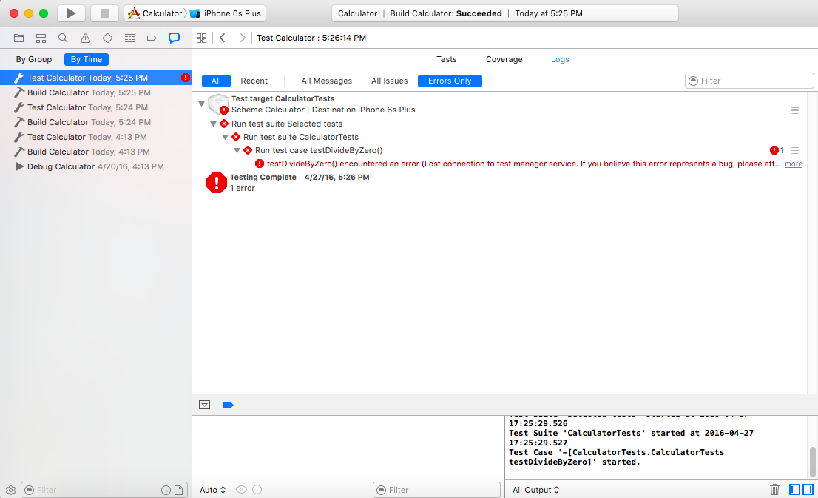
Unit Testing

Slide 24
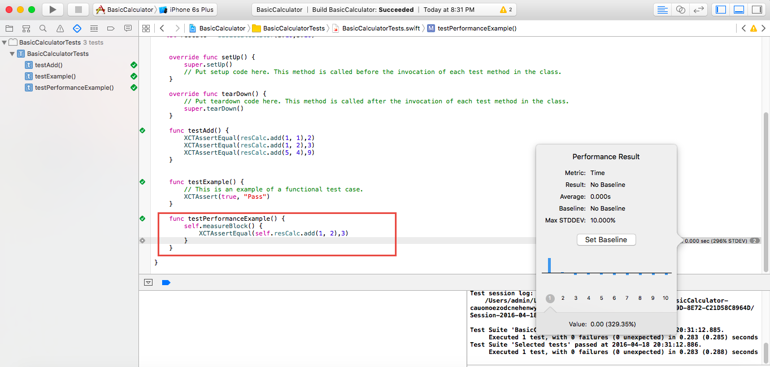
Unit Testing

Slide 25
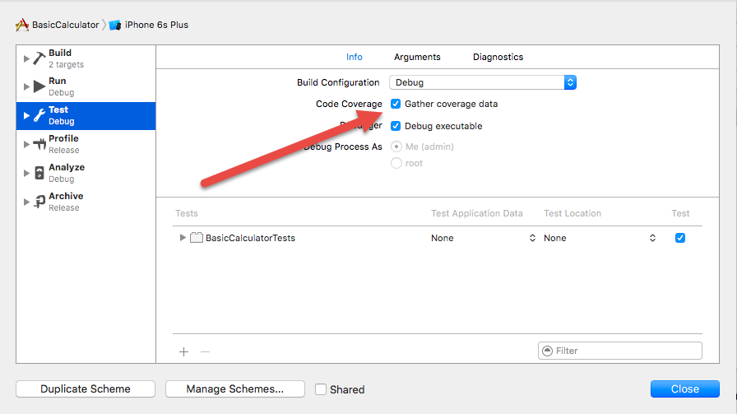
Unit Testing

Slide 26
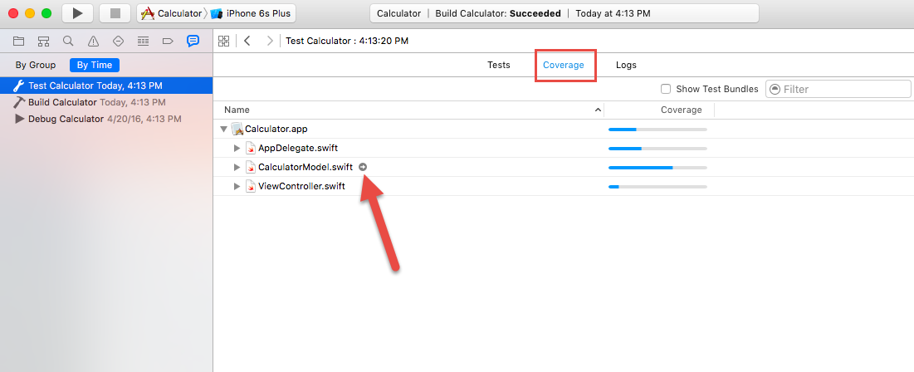
Unit Testing

Slide 27
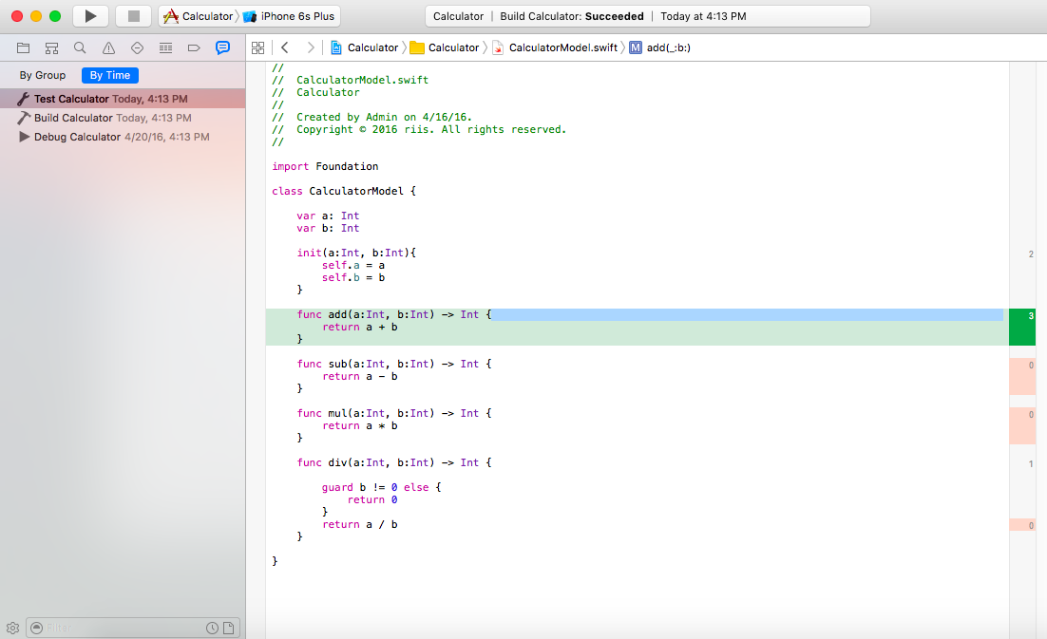
Unit Testing

Slide 28
Agenda
Unit Testing – Tools of the trade
Assignment – upload build to app store

Slide 29
Assignment

